Slide 1
Lab Assignment # 8 Methods
PSY 15
Mandy Small
April 14, 2021

Slide 2
Instructions
Submitting 2 pieces of your project proposal
Title Page (you submitted this already in Assignment 6)
Method Section
Assignment #8 is worth 20 points

Slide 3
Title Page (reminder)
The title page is one page (on a separate page). It includes
Full title of your proposal
Your name
Your affiliation (University of California, Merced)
The course number and name (PSY 15: Research Methods)
The course instructor’s name and title (Dr. Haiyan Liu)
The assignment’s due date
A page number (which also appears on the following pages).
This is a great time to doublecheck your formatting to avoid losing points

Slide 4
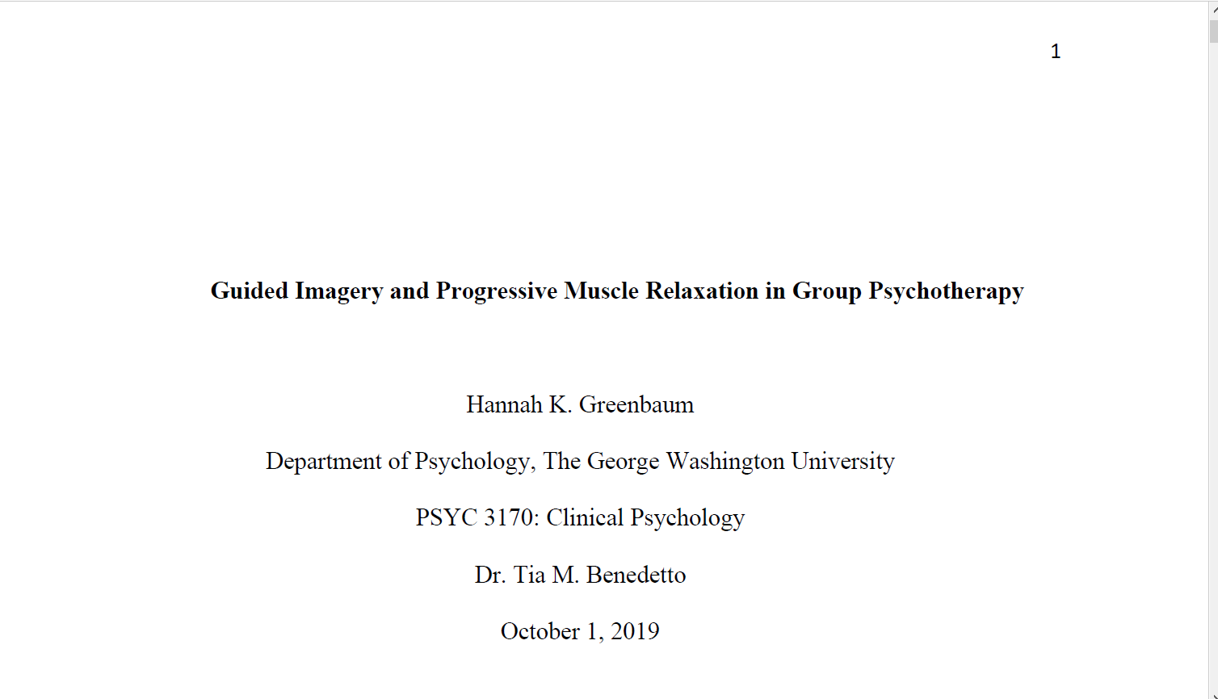
Page number in the header beginning on the title page
The paper's title should be centered, bold, and written in title case. It should be three or four lines below the top margin of the page.
Author name is written below the title, with one double-spaced blank line between them. Names should be written as follows:
First name, middle initial(s) (optional), last name.
Authors' affiliations follow immediately after their names. Then the number and name of the course, the instructor's name and title, and the assignment's due date.

Slide 5
Methods
Method Section - includes 3 sections
Participants: describe who your participants would include (i.e., How many? From where will you recruit them? What age group are you looking at? etc… be specific!).
Measures: Describe any measures/instruments you would use and cite sources (if you are using an existing questionnaire/survey). Exactly how are you going to measure each - and EVERY – variables.
Procedure: Describe exactly how you would collect data (i.e., What is the design of your study and how exactly will you carry it out?) - What will you tell participants? In what order will you give the surveys? - i.e., What does the participant experience from the beginning to end of a data collection session.
The purpose of a methods section is to describe your study so well that someone would be able to replicate your work. Be very specific and precise with your information. Think of it like a guidebook.

Slide 6

Weak and Strong Methods SubSections Participants
Twenty-two first year industrial trade students enrolled in a training course at a Sydney company participated in the experiment. The students were from a varied educational backgrounds but all had completed at least Year 10 of high school and all understood electrical principles at a basic level ….. Students who had completed further studies were excluded from the study. …..
A group of students participated in the study.

Slide 7
Weak and Strong Methods SubSections Materials
Study included three tests measuring cognitive load.
The instructional materials used in the experiment consisted of information on three electrical safety tests that are performed on 240 volt electrical appliances using a volt meter….. Subjective ratings were used in the experiment to measure cognitive load as they “provide a powerful …(measure of) the subjective experience of workload” (Gopher & Braune, 1984: 529; see also Paas & van Merrienboer, 1993; 1994) since students have little difficulty assigning a numerical value to the imposed mental workload…..A copy of the subjective mental load rating scale used in the experiment has been included in Appendix 4. The test material consisted of test items and equipment for both written and practical tests. Each test item was designed to be objective and was marked as either correct or incorrect. The written test consisted of twenty three items. …

Slide 8
Weak and Strong Methods SubSections Procedure
Participants studied materials and rated mental effort.
All the students were randomly assigned to either the isolated-interacting elements instruction or the interacting elements only group with 11 students in each group. They were tested individually, in a quiet room. ….. At the completion of the study phase, the students were provided with a subjective mental load rating scale, the format of which was explained to both groups. They were asked to rate the mental effort involved in understanding all of the electrical tests described in their training booklet on the scale ….. The test section of the experiment followed. The students were asked to complete the written test, described in the materials section…

Slide 9
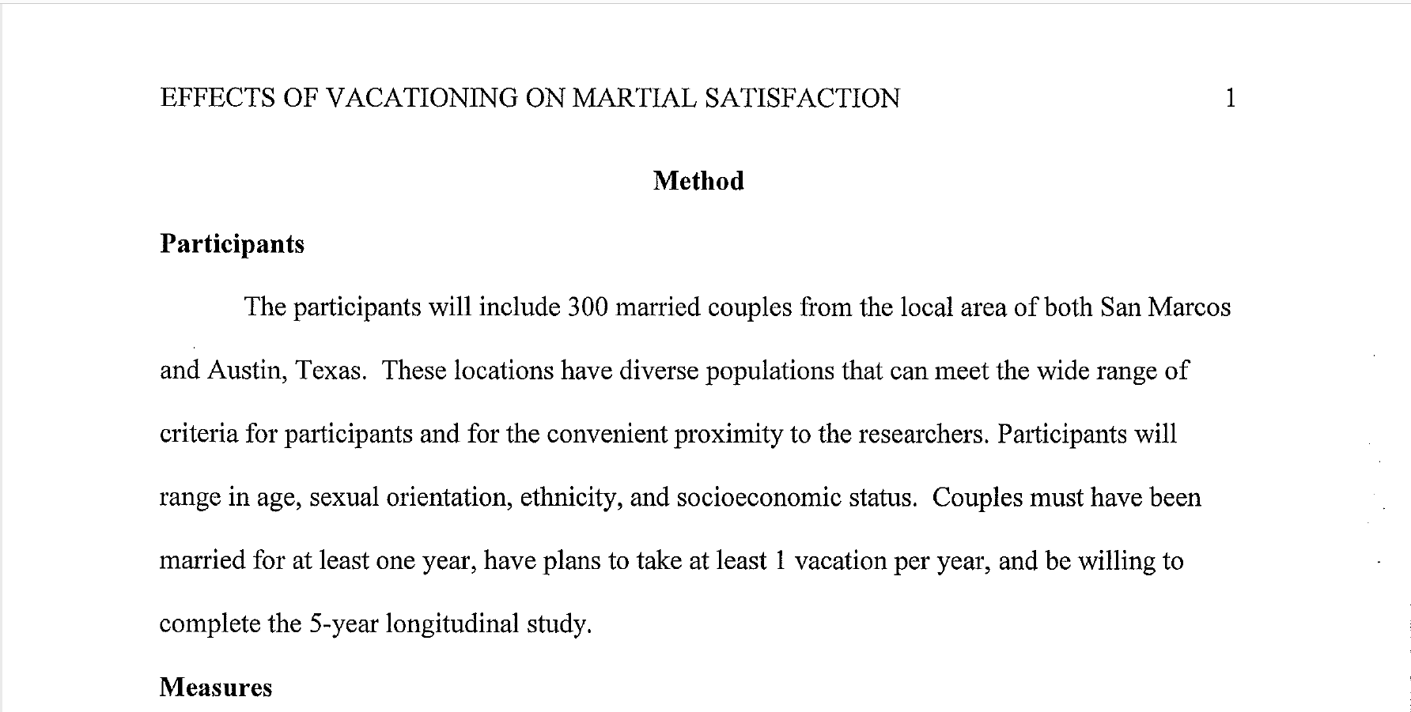

Slide 10
Formatting and Due Date
Type this assignment
12 point, Times New Roman font
APA formatting (check the headings and subheadings section!)
Submit your work to CatCourses by 11:59 PM on April 21 (no late work will be accepted)
Pdf format only

Slide 11
If You Are Still Feeling Overwhelmed…
Please read the methods sections of the following research papers (on CatCourse):
Linnemann, A., Strahler, J., & Nater, U. M. (2016). The stress-reducing effect of music listening varies depending on the social context. Psychoneuroendocrinology, 72, 97-105.
Ibañez, G. E., Dillon, F., Sanchez, M., De La Rosa, M., Tan, L., & Villar, M. E. (2015). Changes in family cohesion and acculturative stress among recent Latino immigrants. Journal of ethnic & cultural diversity in social work, 24(3), 219-234.
Kelly, M. M., Tyrka, A. R., Anderson, G. M., Price, L. H., & Carpenter, L. L. (2008). Sex differences in emotional and physiological responses to the Trier Social Stress Test. Journal of behavior therapy and experimental psychiatry, 39(1), 87-98.

